Slide 1
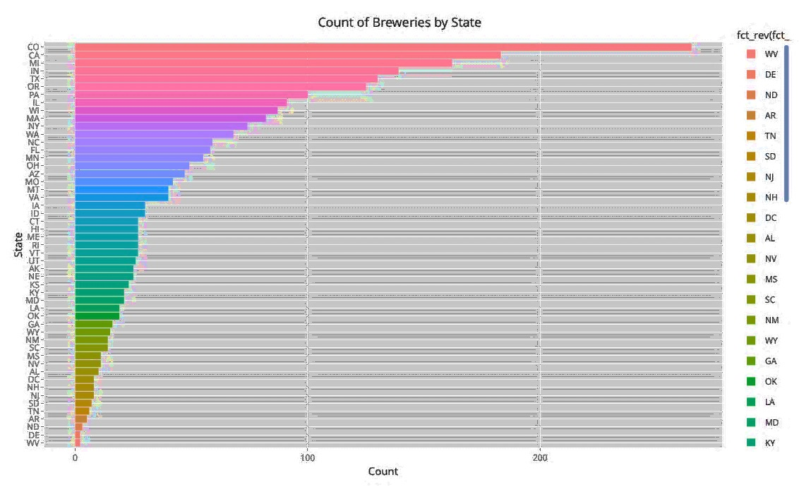
ATTRITION
PREDICTOR
Identification & Mitigation Analysis
Analytics
DDS
Project Team:
Heindel Adu
Ross Fu
Stephen Johnson
Anthony Yeung

Slide 2
American Craft Brewery:
Insights and Analysis.
Great Marks Private Equity, based in Denver Colorado, has retained AGH Data Consult Inc. to evaluate certain craft beer data, provide insights and help chart additional steps toward entering this unique and growing market. Focus of this study sought to address among other things:
Market penetration of craft brewers by state.
The Alcohol By Volume (ABV) of American craft beer
The International Bitterness Units (IBU) of American craft beer
Investigate any relationship between the ABV and IBU
Investigate if the State of brew has any impact on the ABV or IBU or both
Analytics
DDS
AGH DATA
CONSULT
Spring 2019

Slide 3
Content:
Great Marks Private Equity, based in Denver Colorado, has retained AGH Data Consult Inc. to evaluate certain craft beer data, provide insights and help chart additional steps toward entering this unique and growing market. Focus of this study sought to address among other things:
Market penetration of craft brewers by state.
The Alcohol By Volume (ABV) of American craft beer
The International Bitterness Units (IBU) of American craft beer
Investigate any relationship between the ABV and IBU
Investigate if the State of brew has any impact on the ABV or IBU or both
Analytics
DDS
DDS
CONSULT
Spring 2019

Slide 4
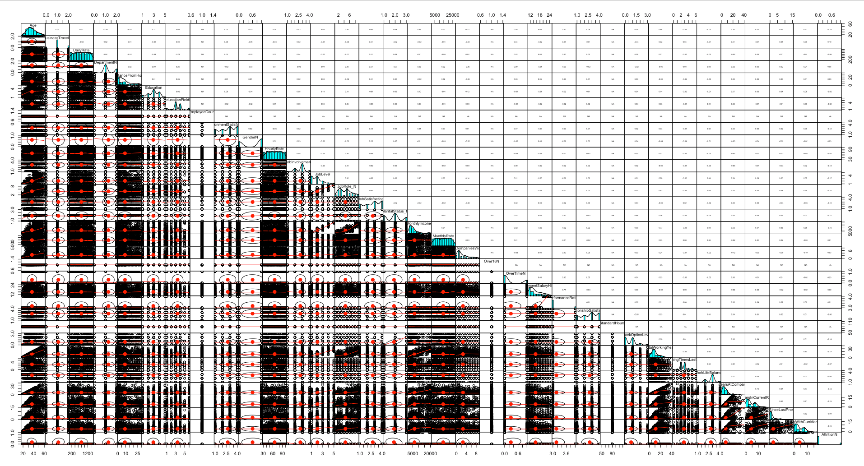
Principal Component Analysis | PCA
Daestrunt od qui que sectur as modi cumqui inus si bea non nus exeratio. Mil exerro erferum re corro omnient quam atiat.
STOCK
HOLDER

Slide 5
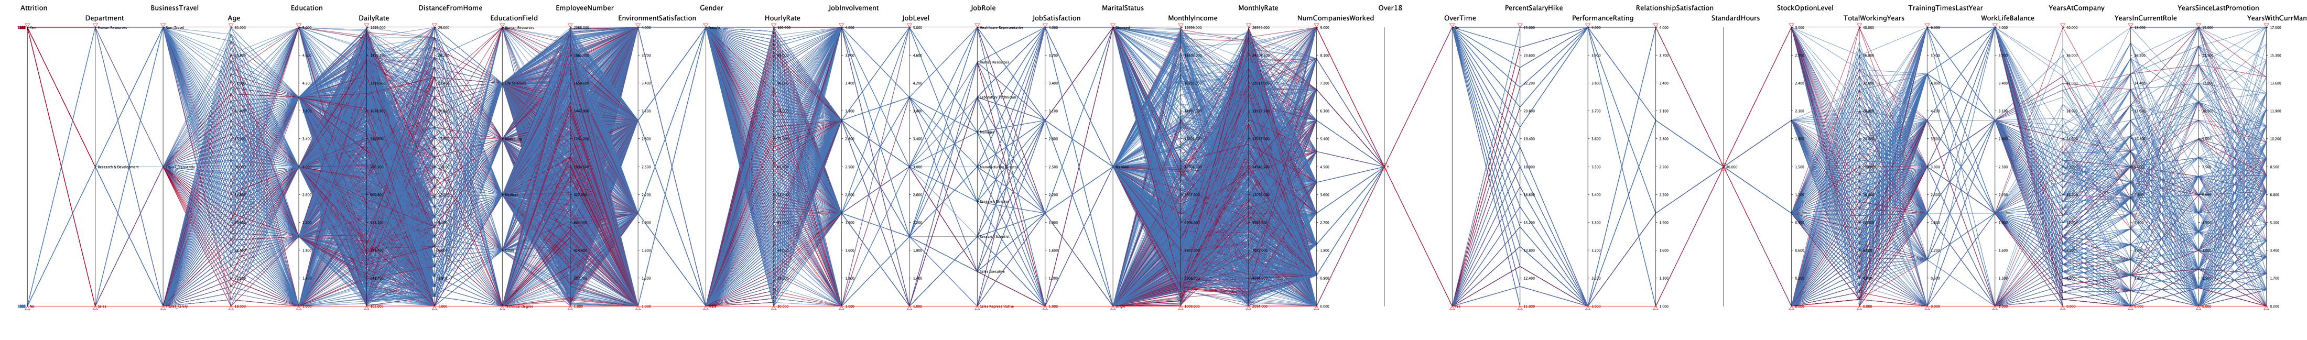
Count of Beer Brands per State
Daestrunt od qui que sectur as modi cumqui inus si bea non nus exeratio. Mil exerro erferum re corro omnient quam atiat.
STOCK
HOLDER
150
100
50

Slide 6
ABV vs IBU per State
STOCK
HOLDER
Higher Concentration
Scatter plot of ABV vs IBU by state.
Colored by state.

Slide 7
ABV vs IBU
All Available States
STOCK
HOLDER
Daestrunt od qui que sectur as modi cumqui inus si bea non nus exeratio. Mil exerro erferum re corro omnient quam atiat.

Slide 8
ABV vs IBU Heat Map
All Available States
STOCK
HOLDER
Daestrunt od qui que sectur as modi cumqui inus si bea non nus exeratio. Mil exerro erferum re corro omnient quam atiat.

Slide 9
STOCK
HOLDER
ABV vs IBU Per State

Slide 10
Boxplot of ABV Per State
STOCK
HOLDER
Daestrunt od qui que sectur as modi cumqui inus si bea non nus exeratio. Mil exerro erferum re corro omnient quam atiat.

Slide 11
Boxplot of IBU Per State
STOCK
HOLDER

Slide 12
Alcohol By Volume:
Highest ABV (.128)
Upslope Brewing Co, Boulder Co
Lee Hill Series Vol 5
(Quadrupel)
Lowest ABV (.001)
Uncommon Brewers, Santa Cruz CA
Scotty K
(Low alcohol beer)
Highest IBU Value (138)
Astoria Brewing Co, Astoria OR
Bitter Bitch Imperial IPA
(American Double / Imperial IPA)
Lowest IBU Value (4)
Anderson Valley Brewing Co, Boonville CA
Summer Solstice (Cream Ale) 2009/2011
KEY
TAKE
AWAYS
International Bitterness Units:

Slide 13
All other columns had no missing data
Highest IBU Value (138)
Astoria Brewing Co, Astoria OR
Bitter Bitch Imperial IPA
(American Double / Imperial IPA)
Lowest IBU Value (4)
Anderson Valley Brewing Co, Boonville CA
Summer Solstice (Cream Ale) 2009/2011
Column Missing Data Count
ABV | IBU | Beer Style
62 | 1,005 | 5
KEY TAKE-AWAYS
International Bitterness Units:
Daestrunt od qui que sectur as modi cumqui inus si bea non nus exeratio. Mil ortodova exerro erferum realer socorro omnient quam

Slide 14
Marketing Channels Data:
Greater insights into craft beer consumer behavior
Sales Volumes
Craft Beer Pricing Data
Raw-material Sourcing Data
Regulatory Atmosphere For Craft Beer
NEXT
STEPS

Slide 15
QUESTIONS ?
THANKS
AGH DATA CONSULT INC.
DALLAS, TX

Slide 16
AGH DATA CONSULT INC.
P | 03
AGH
DATA CONSULT Inc.
Data like never Before.
We are a Data Science Group dedicated to helping our clients make sense from their data.

